Slide 1
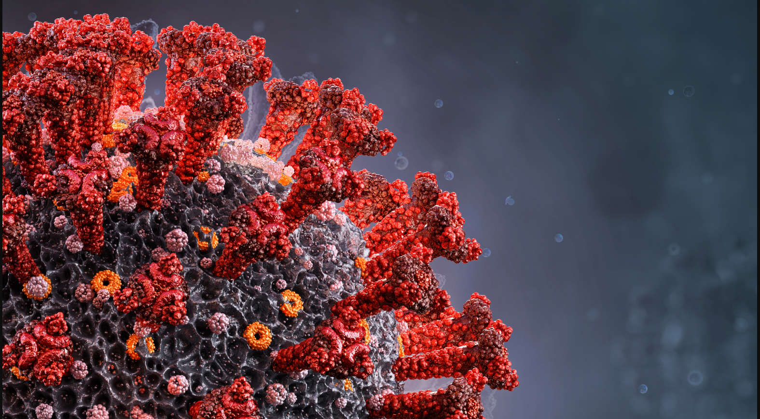
Machine Learning Models To Predict Covid Mortality
Rutgers Bootcamp for Data Science
Abraham Abate, Ashish Shukla,
Jialin Huang, Roger Vroom
March 23, 2023
Image: Corona Borealis Studio/Shutterstock.com

Slide 2




Team Introduction
Abraham Abate
Cruncher of numbers and dominator of databases
Ashish Shukla
Philosopher of
“One more thing”
Jialin Huang
Artistic and Visual Director
Roger Vroom

Slide 3
Background
Coronavirus disease (COVID-19) is an infectious disease caused by a newly discovered coronavirus. Most people infected with COVID-19 virus will experience mild to moderate respiratory illness and recover without requiring special treatment, but some Covid patients with certain medical conditions will develop severe symptoms leading to death.
The main goal of this project is to build a machine learning model that, given a Covid-19 patient's current symptom, status, and medical history, will predict whether the patient is high risk or not.

Slide 4
Objectives
We decided to focus on Covid-19 due to its continued impact on the world's population.
Dataset, provided by Mexican government, consists of 21 unique features and 1,048,576 unique patients
Compare and evaluate performances of different machine learning models
Predict a person’s likelihood contract severe Covid by pre-existing conditions (features)
Develop website to visualize medical conditions correlation to Covid and mortality

Slide 5
Data Exploration
14 different pre-existing medical conditions (Features)
Use 6 different Supervised Machine Learning models
Determine and rank each pre-existing conditions’ correlations to Covid mortality (Target)

Slide 6
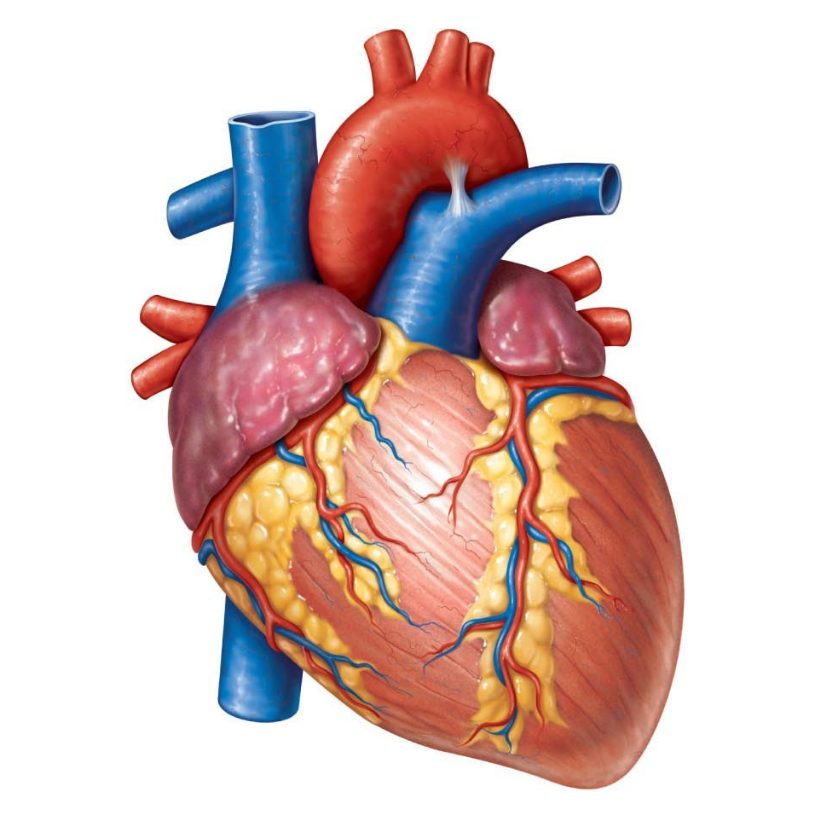


Pre-existing Diseases or Conditions
This Photo by Unknown Author is licensed under CC BY
This Photo by Unknown Author is licensed under CC BY-NC-ND
This Photo by Unknown Author is licensed under CC BY-NC-ND
Older people, and those with underlying medical conditions like cardiovascular disease, diabetes, chronic respiratory disease, and cancer, have higher chance to develop serious Covid symptoms, possibly leading to mortality
https://www.mayoclinic.org/diseases-conditions/coronavirus/in-depth/coronavirus-who-is-at-risk/art-20483301

Slide 7
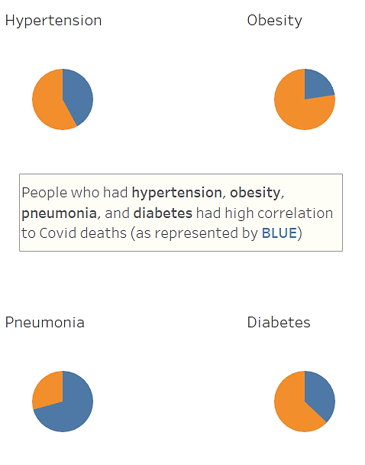
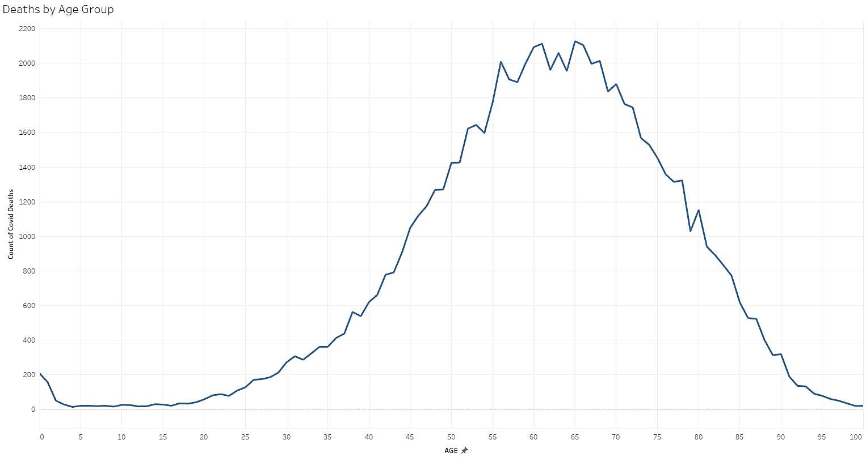
Tableau Visualization *to be demonstrated in website*

Slide 8
Prediction Model/Machine Learning
Covid-19 Dataset
Clinical data with pre-conditions
Machine Learning
Logistic Regression
Application
Mortality and severity prediction
Random Forest
Gradient Boosted Classifier
Easy Ensemble AdaBoost Classifier
Support Vector Machine
Deep Learning
PostgreSQL Database
Feature Importance
Data Transformation

Slide 9
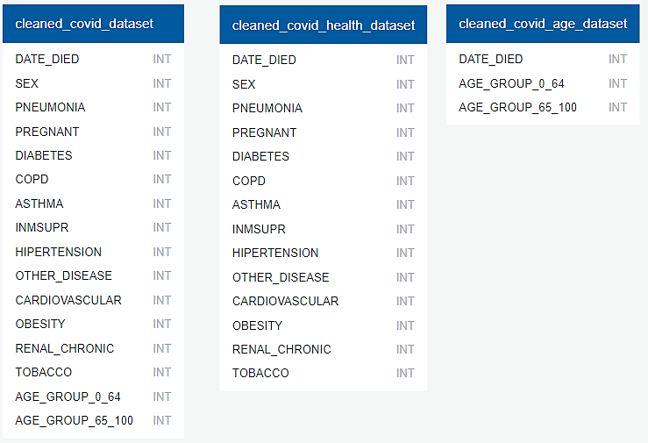
PostgreSQL Database
Process/ steps to clean up/ transform data
Features are in Boolean (1 for yes, 2 for no)
All missing and NA values were dropped (values >2)
DATE_DIED dropped “9999-99-99” indicating survival
Age group divided to 0-64 and 65-100

Slide 10
Machine Learning Prediction
 | Logistic Regression | Random Forest | Gradient Boosted Classifier | Easy Ensemble AdaBoost Classifier | Support Vector Machine | Deep Learning
Training Score | 0.914 | 0.896 | 0.896 | 0.849 | 0.913
Testing Score | 0.912 | 0.911 | 0.912 | 0.845 | 0.911 | 0.912
Six ML models were trained on top of these 14 features to predict patients' mortality or discharge outcomes (target).
The logistic Regression model performs best with an accuracy of 91.4%, followed by SVM (91.3%) and Deep learning (91.2%).
The trained models were then tested on the test dataset. Three models (Logistic Regression, Gradient Boosting Classifier, neural network) had the best performance with an accuracy of 91.2%, followed by random forest and support vector machine (91.1%).

Slide 11
Classification Report
 | Logistic Regression | Random Forest | Gradient Boosted Classifier | Easy Ensemble AdaBoost Classifier | Support Vector Machine
Accuracy | 0.912 | 0.912 | 0.911 | 0.896 | 0.911
Precision | 0.61 | 0.61 | 0.59 | 0.39 | 0.61
Recall/ Sensitivity | 0.42 | 0.39 | 0.46 | 0.84 | 0.39
F1 | 0.50 | 0.48 | 0.52 | 0.53 | 0.48
Precision rate of all ML models are at ~ 0.60 and recall rate at ~ 0.40 except Easy Ensemble
Easy Ensemble has the highest recall/sensitivity rate at 0.84, but the lowest precision rate at 0.39
F1 scores of all ML models are consistent at ~ 0.50

Slide 12

Obstacles/Challenges
Only 10% accuracy score for SVM
Resolved by changing y-prediction scaled data to y-prediction data
CDC data was too large (>90 MB) including 95 normalized features

Slide 13
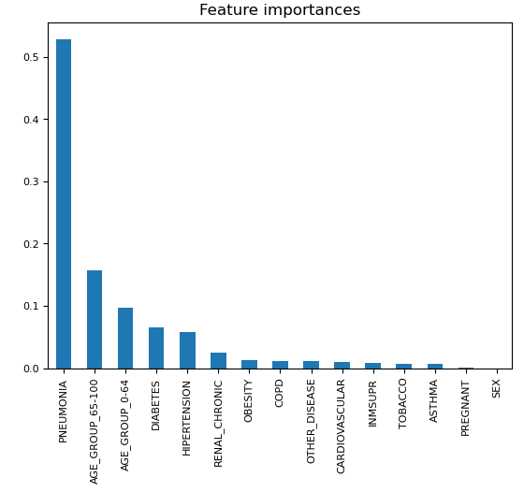
Feature Importance for Random Forest model
Features were ranked from the highest (most useful to predict target) to the lowest (least useful, “noise”)
Pneumonia and age were the two top features and contributed the most to the accuracy of the model

Slide 14
Additional Resources
Tableau: https://public.tableau.com/app/profile/jialin.huang3459/viz/CovidmortalitygroupprojectMar-2023/Story1
Github:
https://github.com/rvroomiii/group_hub
Website:
https://rvroomiii.github.io/group_hub/

Slide 15
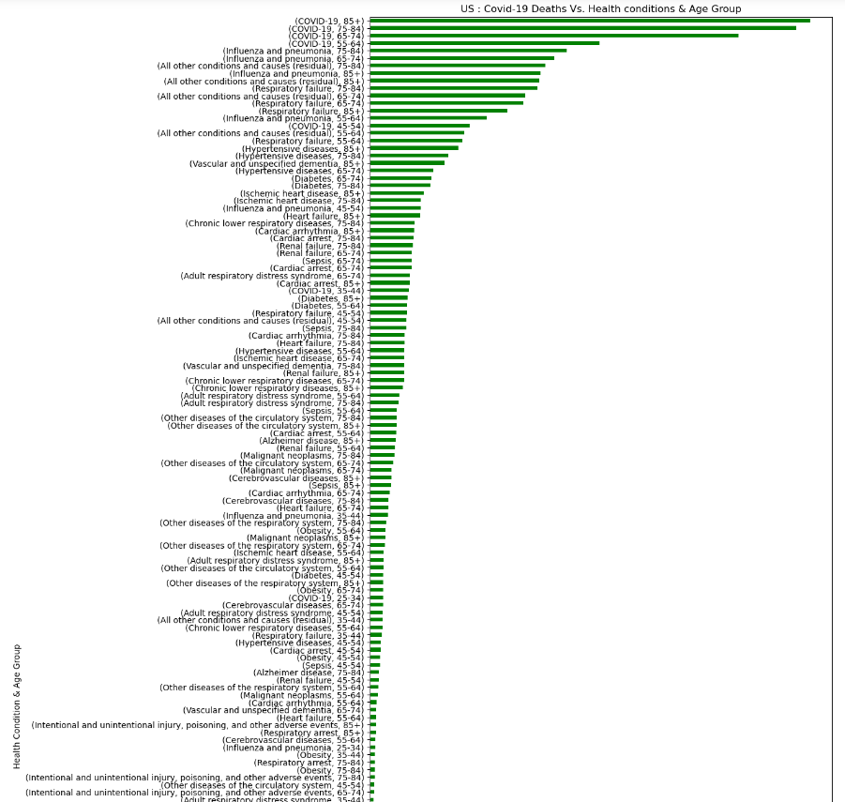
Future Analysis
Recommendations for future analysis:
US CDC data use in conjunction (state to state comparison, urban vs rural)
US CDC data (>90 MB, 95 normalized features) too large for machine learning/model prediction
Anything that the team would have done differently:
Further break down age group into more subgroups
Compare datasets from different sources
Website in development to predict user’s severity with Covid based on medical conditions and age

Slide 16
Credits
Data Source: https://www.kaggle.com/datasets/meirnizri/covid19-dataset
https://datos.gob.mx/busca/dataset/informacion-referente-a-casos-covid-19-en-mexico
Software/Tool used:
HTML
Tableau
Python
Pandas
Matplotlib
NumPy
SciPy
PostgreSQL
Jupyter Notebook
Visual Code Studio

Slide 17
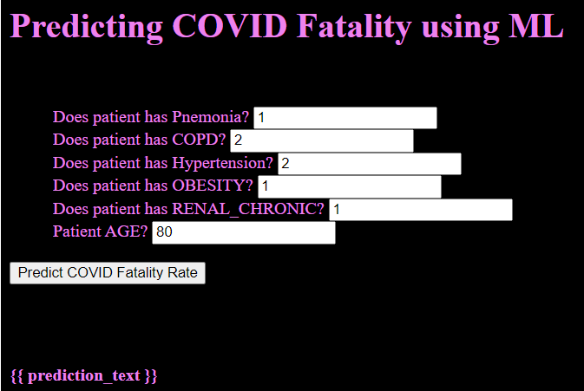
Website Playground
Tableau visualization
https://rvroomiii.github.io/group_hub/

